Slide 1


Slide 2

CMF DESIGN AWARD APPLICATION FORM
Company name
Product name
Department name
Industry
Main product
Office address
Website |  | Postal Code
Applicants, up to 6 people, will be reflected on the finalist/award certificates
1 | Name |  | Post |  | Phone number |  | E-Mail
2 | Name |  | Post |  | Phone number |  | E-Mail
3 | Name |  | Post |  | Phone number |  | E-Mail
Contact name |  |  | Post |  | Phone number |  | E-Mail
☐ Listed works ☐ Unlisted works
*Before the final review, the unlisted works can be kept confidential (please specify). If there is no remarks, the works would be displayed publicly by default, including but not limited to pictures and texts. After the final evaluation, all works will no longer be kept confidential.

Slide 3
INVOICE INFORMATION FORM
Special VAT invoice |  | General VAT invoice
Company name
Duty paragraph
Bank branch
Account number
Office address
Office number
Mailing Information
1 | Name
2 | Address
3 | Phone Number
Note:​ The application fees for the CMF Design Awards consist of three parts: the registration fee, the shortlist service fee, and the award service fee.
Registration Fee:​Early Registration (Free before May 29, 2026)；Early Bird (50% off, 400 RMB before July 31, 2026)；Standard Registration (800 RMB, from August 1 to September 20, 2026).
Shortlist Service Fee:​ 3,000 RMB (to be paid only upon being shortlisted).This fee includes: the shortlist certificate, jury remuneration, participation in the awards ceremony, and promotional expenses.
Award Service Fee:​Award-winning works: 15,000 RMB per piece.Gold Award winners: 25,000 RMB per piece.(No fee is required for entries that do not win an award.)This fee includes: participation in the awards ceremony, trophy, award certificate, jury remuneration, exhibition costs, and post-award promotional expenses.

Slide 4
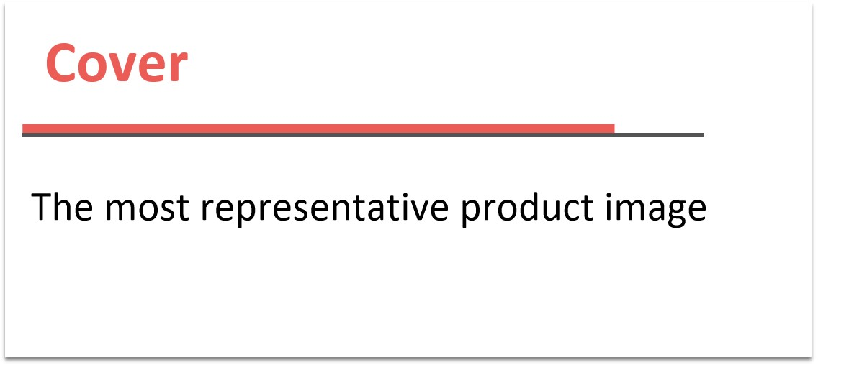

Slide 5
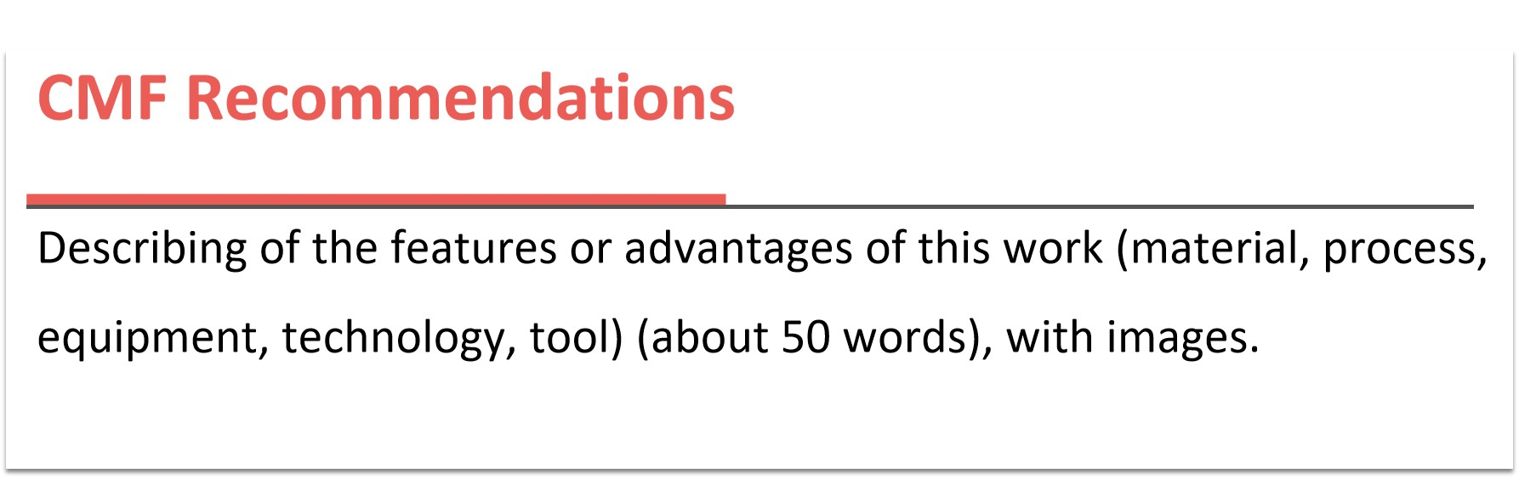

Slide 6
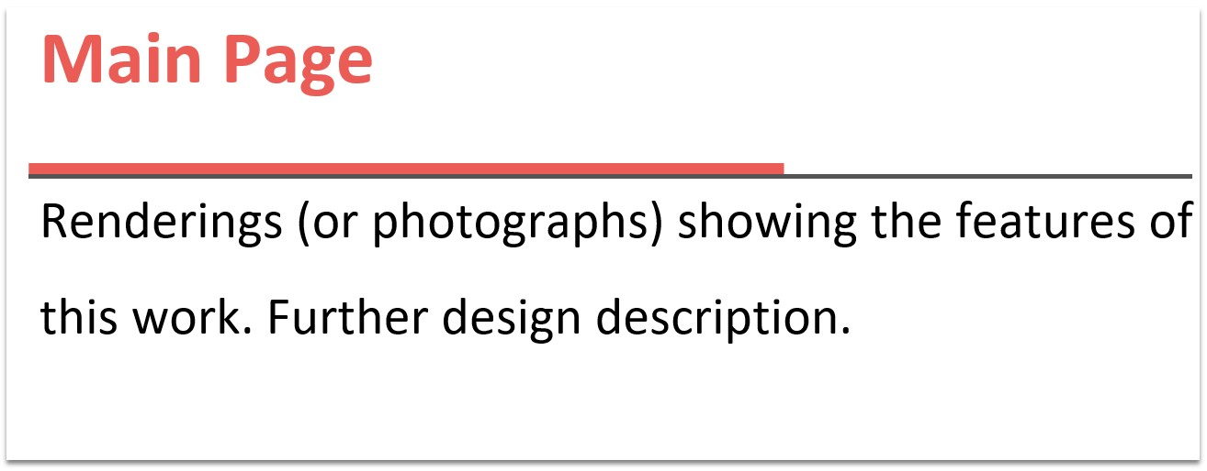

Slide 7
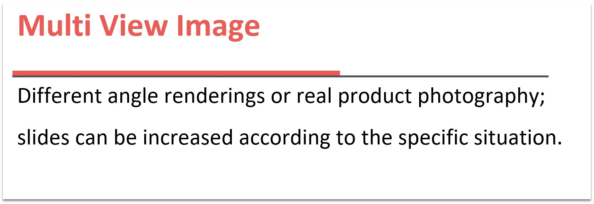

Slide 8
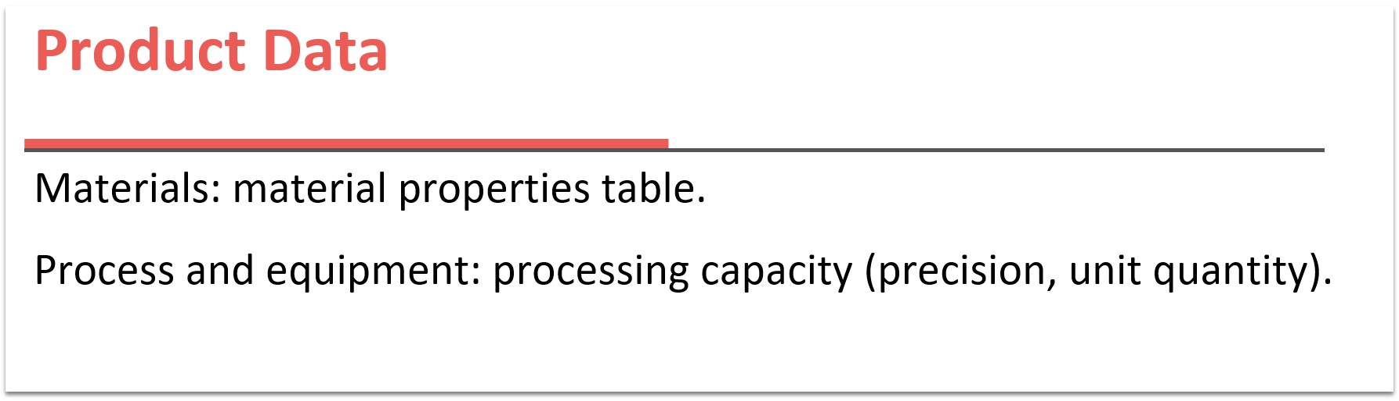

Slide 9
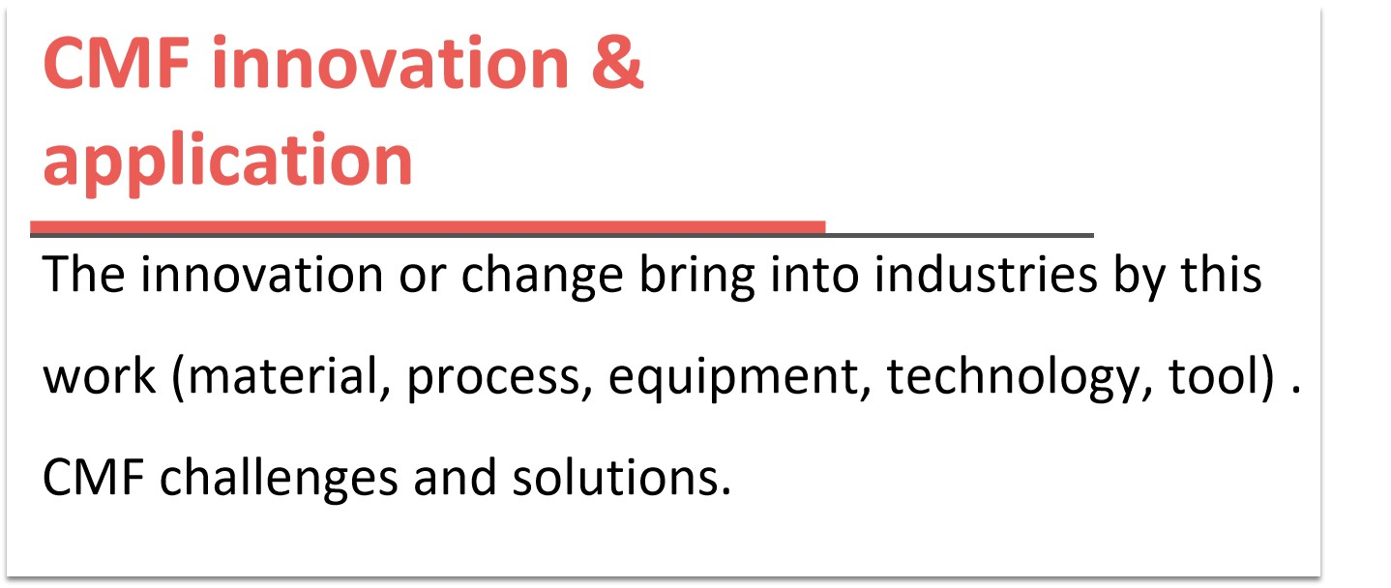

Slide 10
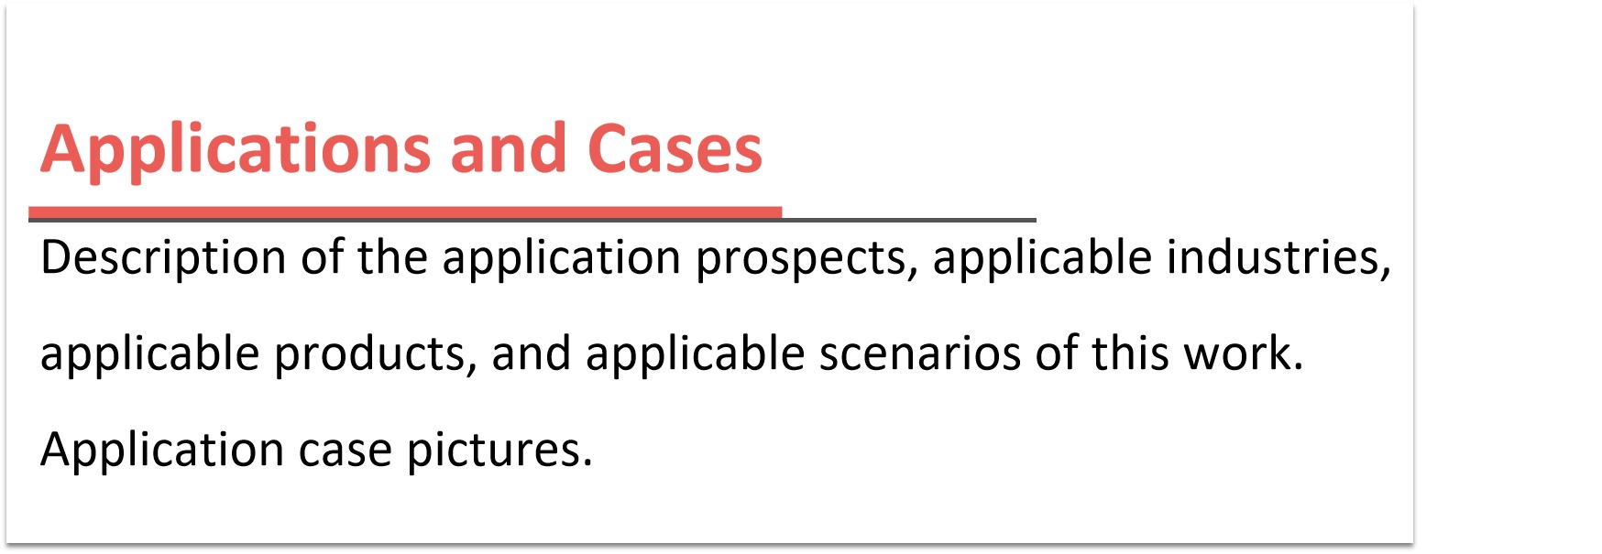

Slide 11
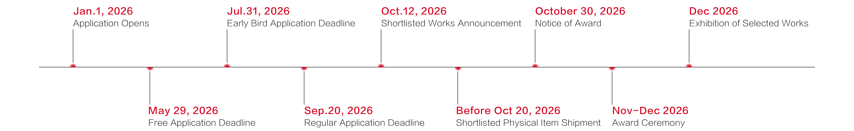
＊Please delete this page when submitting your work.
Remark:
1. Please complete this application template as requird.
2. Keep the file layout and retain CMF DESIGN AWARD LOGO in the upper right corner.
3. Submit this file to the email: award@cmfdesign.net
Schedule:
Winning Service:
Online display, trademark authorization, award ceremony, product exhibition, preferential policy for subsequent application, and propaganda.
-----------------
Organizing Committee of CMF DESIGN AWARD
Tel: +86 0755-33964539
Cel: +86 185 6572 5894 (Working Group)
E-mail: award@cmfdesign.net
Web: www.cmfdesignaward.com
Add: Room 802, Building B, Longbang Kexing Science Park,Guangming District, Shenzhen, Guangdong Province, China

